Slide 1
🔍
Project Overview
Dataset: NEU Metal Surface Defects (1800 images) Classes: 6 defect types × 300 images each Best Model: Random Forest (77.78% accuracy) Deployment: Streamlit Web Application
Surface Defect
Detection System
Machine Learning for Industrial Quality Control
Crazing • Inclusion • Patches • Pitted Surface • Rolled-in Scale • Scratches
Team Members
Gokul A R • Krishnendhu M S • Archana T
April 2026

Slide 2
Problem Statement
Why automated surface defect detection matters
The Challenge
Our Solution
Manual inspection is slow, inconsistent, and expensive.
Steel surface defects directly impact product quality and safety in manufacturing.
Traditional vision systems require expensive hardware and manual tuning.
✅ ML-based image classification
✅ Trained on 1800 real defect images
✅ 6 defect categories supported
✅ Real-time web app deployment
✅ 77.78% accuracy with Random Forest

Slide 3
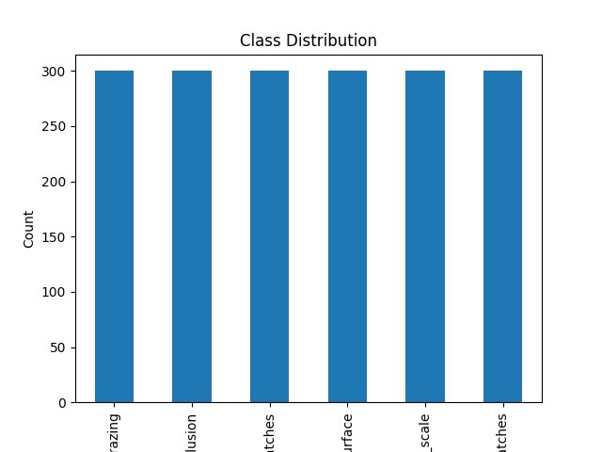
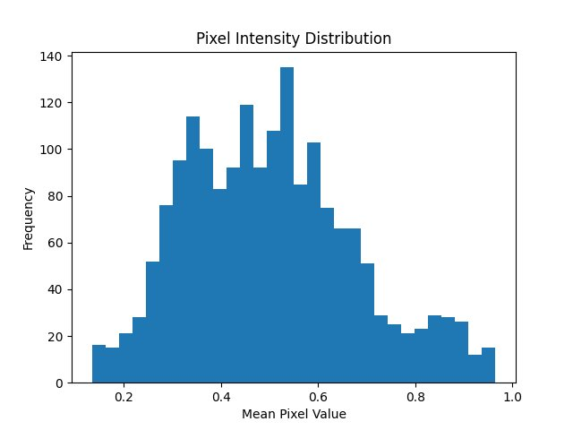
Dataset & Exploratory Data Analysis
NEU Metal Surface Defects Database
Class Distribution (300 images × 6 classes)
Pixel Intensity Distribution
📊 Perfectly balanced dataset — no class imbalance issues

Slide 4
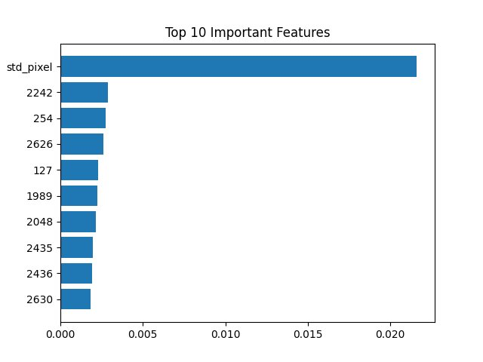
Feature Engineering
Extracting meaningful features from 64×64 grayscale images
🖼️
📐
🔲
Pixel Values
Statistical Features
Edge Features
64×64 image flattened to 4096 pixel intensity values (0–1 normalized)
Mean pixel intensity and Standard deviation to capture brightness & contrast
Canny edge detection mean — captures structural patterns and boundaries
Top 10 Important Features (Random Forest) — std_pixel dominates

Slide 5
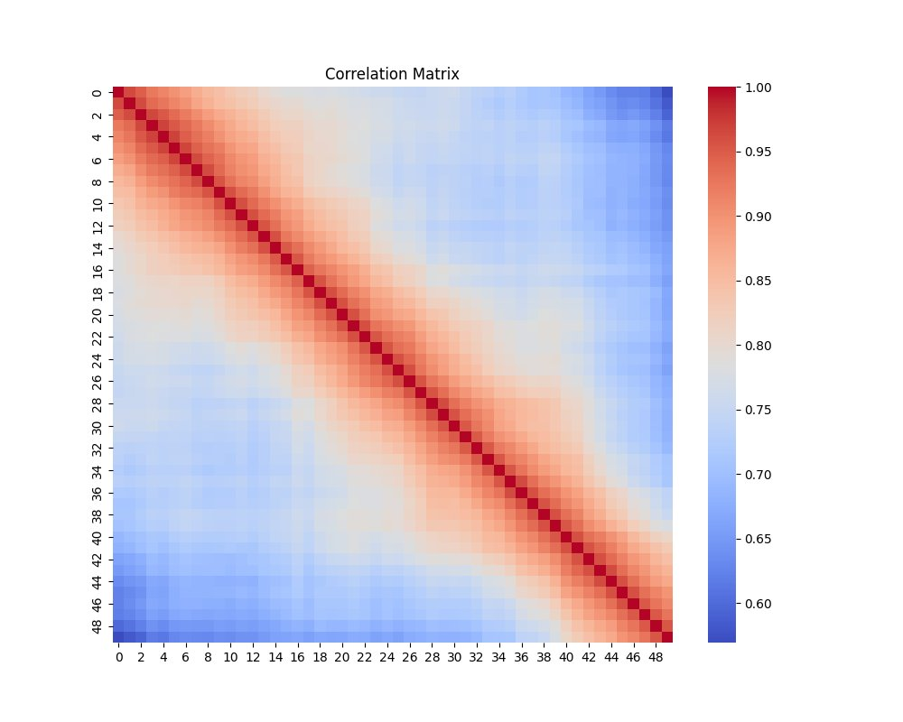
Feature Correlation Analysis
Pixel-level correlation heatmap across feature space
High Correlation (Red)
Spatially adjacent pixels share similar intensity — expected for structured surfaces
Low Correlation (Blue)
Distant pixel pairs are weakly correlated — provides useful discriminative information
Diagonal Pattern
Strong diagonal confirms each pixel is most correlated with itself and nearby neighbors
📌 Total features per sample: 4096 pixels + 3 engineered = 4099

Slide 6
Model Training & Comparison
4 classifiers trained on 80/20 train-test split
Model | Accuracy | Result
Random Forest | 77.78% | 🏆 Best
SVM | 70.56% | 2nd
Decision Tree | 70.28% | 3rd
Logistic Reg. | 47.78% | 4th
✅ Random Forest saved as production model → models/model.pkl

Slide 7
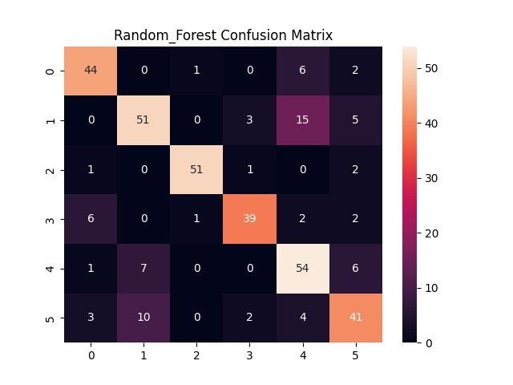
Model Evaluation — Random Forest
Confusion matrix and per-class performance
Crazing
~83%
Minor confusion with scratches
Inclusion
~68%
Confusion with rolled-in scale
Patches
~93%
Highest accuracy class
Pitted Surface
~78%
Some confusion with crazing
Rolled-in Scale
~79%
Moderate misclassifications
Scratches
~68%
Random Forest Confusion Matrix (6 classes)
Confused with rolled-in scale

Slide 8
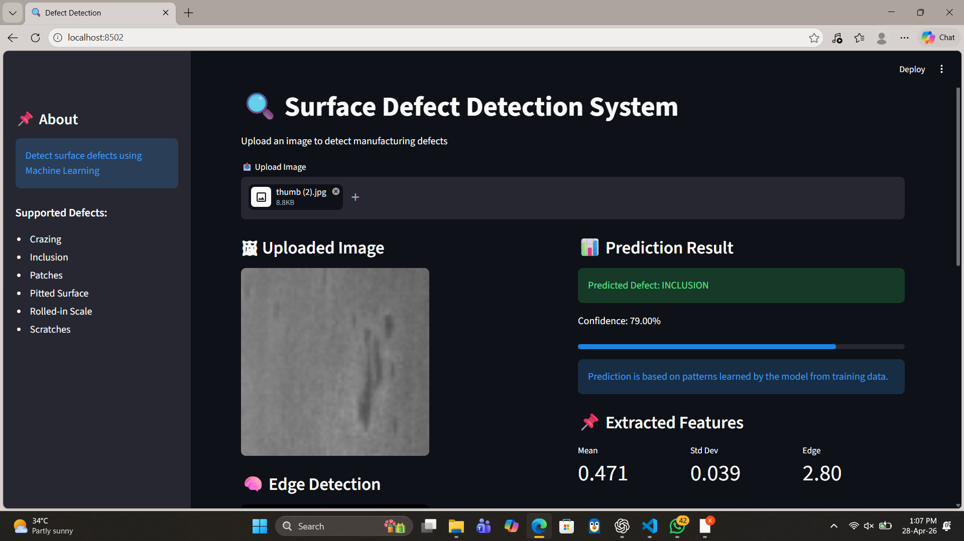
Streamlit Web Application
Real-time surface defect detection interface
https://defect-detection-ml-vhi9bphk8zxpscrfrh5gte.streamlit.app/
📤 Upload any surface image (JPG/PNG)
🔍 Instant defect classification
📊 Confidence score + progress bar
🧠 Edge detection visualization
📌 Extracted feature metrics
💡 Model insight explanation

Slide 9
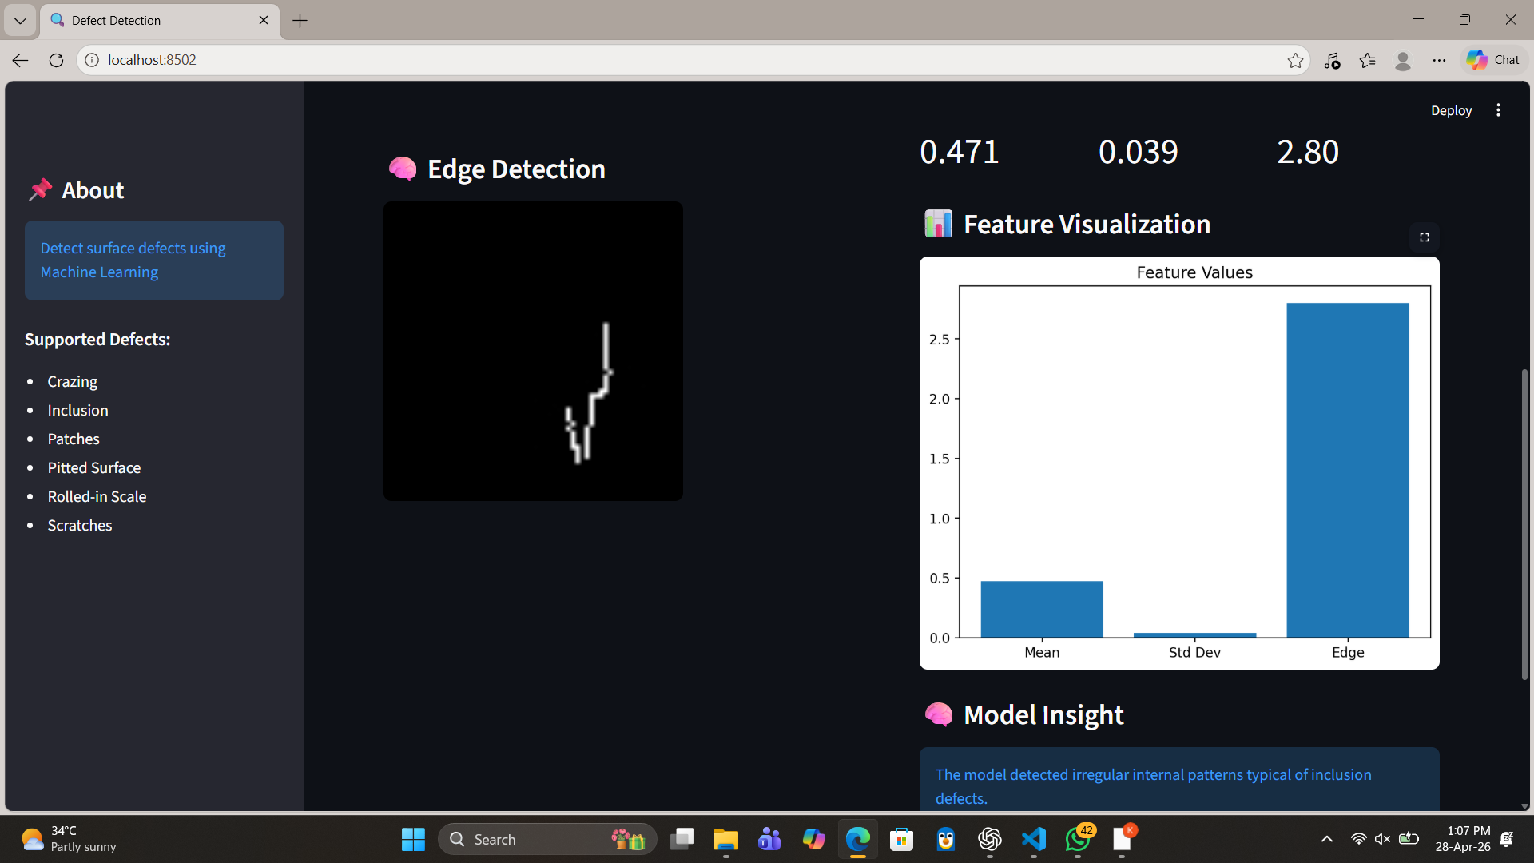

Slide 10
Project Architecture & Workflow
End-to-end ML pipeline
📁
⚙️
🔬
🤖
💾
🚀
Data
Collection
Pre-
processing
Feature
Extraction
Model
Training
Model
Saving
Streamlit
Deploy
NEU-DET
1800 images
6 classes
Resize 64×64
Grayscale
Normalize
4096 pixels
+ Mean/Std
+ Edge
RF / DT /
SVM / LR
Compare
Best model
→ model.pkl
joblib
Web UI
Upload & Predict
Live demo
Tech Stack:
Python 3.12
scikit-learn
OpenCV
Pandas / NumPy
Streamlit
Matplotlib / Seaborn

Slide 11
Conclusion & Future Work
✅ What We Achieved
🚀 Future Improvements
• Balanced dataset of 1800 images processed
• 4099-feature vector per image
• 4 ML models trained and compared
• Random Forest: 77.78% accuracy
• Deployed as interactive Streamlit app
• Full Git workflow on GitHub
• CNN / Deep Learning for higher accuracy
• Transfer Learning (ResNet, VGG)
• Real-time camera feed detection
• Localization: highlight defect region
• Deploy to cloud (AWS / GCP)
• Mobile-friendly app interface
Thank You 🎯

